Slide 1

Face Recognition Using OpenCV
Author: Gabriela Brito

Slide 2
What is Face Recognition?
Face recognition as a biometric authentication method
How does it work?
Face recognition takes into account user convenience
However, it can be prone to false negatives
Biometric authentication systems aim to reduce false acceptance rates (FAR)
Face recognition methods have a higher FAR compared to other biometric methods such as fingerprints or eye scanning
Face recognition methods are able to determine the identification of a person by comparing data from a database of images/videos
Face recognition requires training and classifying known vs unknown images in a database usually through some form of machine learning
Machine learning uses the process of Computer Vision to process images
Machine learning is able to map a face by determining feature vectors such as the height of a nose, the height/width of a face or lips, etc.
Once these feature vectors have been determined, it matches them against the known set of vectors to determine the identification of the person

Slide 3
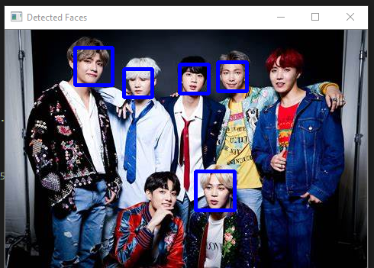
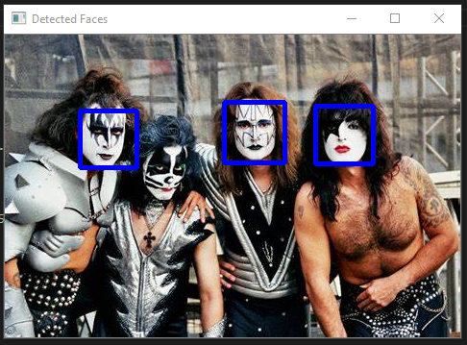
Face Detection Using Haar Cascade Classifiers
Haar Cascade Classifier is used to detect objects
Not very accurate, was not able to detect all faces in some cases

Slide 4
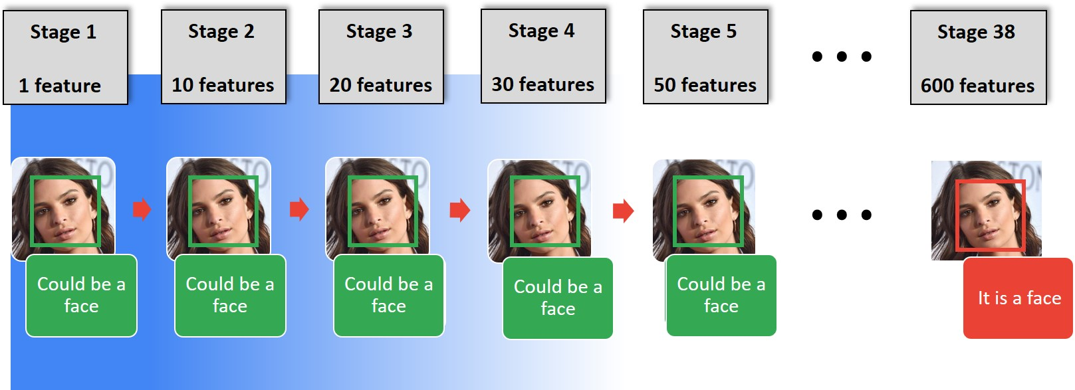
Haar Cascade Classifier
Haar Cascade Classifier is used to detect objects
algorithm that is able to determine that an image is positive or negative
Classifier needs to be trained with thousands of pictures
Used Frontalface Haar Cascade classifier

Slide 5
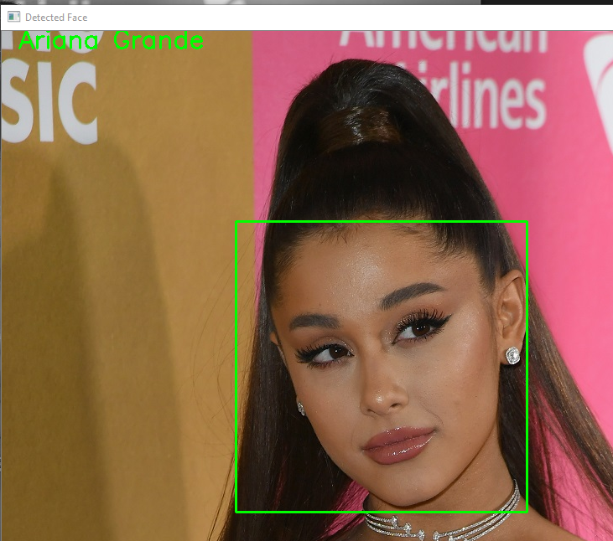
Face Recognition Using OpenCV’s Built-In Recognizer
Different face recognition algorithms
Fisherfaces
Local Binary Patterns Histograms LBPH
Eigenfaces
Speed Up Robust Features SURF
Created a folder with some known faces about 10 of each
Used the LBPH face recognition algorithm
Trained the recognizer on the features list and names
Used that trained model to help identify faces

Slide 6
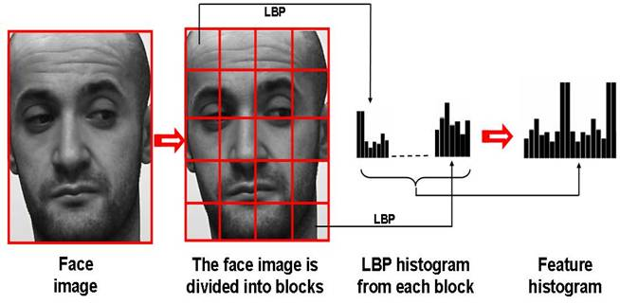
Training the LBPH Face Recognition Algorithm
First step is to determine the parameters, these include radius, grid x, grid y, and neighbors.
The second step is to use a dataset with images of the person/people that are to be recognized. An ID such as a name or number needs to be set for each image.
The third step is to apply the local binary pattern to a grayscale image.
The fourth step is to use the grid x, and y parameters to extract the histogram (divides image into smaller grids).
The last step matches an image to the closest histogram.

Slide 7
Problems
It is easy to spoof facial recognition technology with pictures or videos
Racial and gender bias
High number of false positives
The SAND Lab at University of Chicago has developed Fawkes¹, an algorithm and software tool (running locally on your computer) that gives individuals the ability to limit how unknown third parties can track them by building facial recognition models out of their publicly available photos. At a high level, Fawkes "poisons" models that try to learn what you look like, by putting hidden changes into your photos, and using them as Trojan horses to deliver that poison to any facial recognition models of you.
Privacy and security concerns
Facebook Inc. agreed to pay $550 million to resolve claims it collected user biometric data without consent in one of the largest consumer privacy settlements in U.S. history. (Bloomberg)

Slide 8
Cited Sources
Facebook to Pay $550 Million in Biometric Privacy Accord – Bloomberg
OpenCV: Face Recognition with OpenCV
Face recognition using Artificial Intelligence – GeeksforGeeks
Computer Vision — Detecting objects using Haar Cascade Classifier | by Nabab Khan | Towards Data Science
Face Recognition and Detection Using Python OpenCV – JournalDev
Fawkes (uchicago.edu)

